Slide 1
Introduction to Object Oriented Programming
QA Community
Rosario - Argentina

Slide 2
OBJECT ORIENTED PROGRAMMING
"is a method of implementation in which programs are organized as cooperative collections of objects, each of which represents an instance of some class, and whose classes are all members of a hierarchy of classes united via inheritance relationships" (*)
(*)[Grady Booch (1991) Object-Oriented Design with Applications]

Slide 3
OBJECT
Is an entity that contains:
Attributes: data that describes the state of an object
Methods: actions that changes the state of an object
Each object is able to receive messages, process data and send messages to other objects.
Is an instance of a class

Slide 4
CLASS
Is a generic template for a set of objects with similar features.
Defines a set of variables(state), and a set of methods(behavior)

Slide 5
EXAMPLE: CAR
Is the main element that has a set of characteristics, such as: colour, year, brand.
Also has a set of associated actions, such as: start, stop.

Slide 6

EXAMPLE: CAR
Car
color: String year: Int brand: String
setColor(String) getColor():String setBrand(String) getBrand():String setYear(Int) getYear():Int start() stop()
PLEASE ONLY USE STOCK PHOTOS FROM THE ENDAVA LIBRARY IF NEEDED TO SHOW INDUSTRY CONTEXT AND AVOID USING PEOPLE FACES IN THIS CASE.
Attributes
Methods

Slide 7
THE FOUR PRINCIPLES OF OOP
Abstraction
Encapsulation
Inheritance
Polymorphism

Slide 8
ABSTRACTION
Consists of capturing and classifying the characteristics(attributes) and behaviors(operations) relevant of the real world to solve the problem
Person
name: String age: Int
walk() run() stop() talk(): String

Slide 9
ABSTRACTION
Date
day: Int month: Int year: Int
getDay(): Int getMonth(): Int getYear(): Int compareTo(Date d): Boolean toString(): String

Slide 10
ENCAPSULATION
Is the process of hiding all the secrets of an object that does not contribute to its essential characteristics
Hides the implementation details of an object
The part that is not hidden from an object is its interface
Also is known as information hiding

Slide 11
INHERITANCE
Is a powerful mechanism to deal with the natural evolution of the system and with the incremental modification
Allows to reuse objects to build new objects
There are generic classes (parent/superclass) that group similar characteristics and behaviors for a set of objects and
There are derived classes (child/subclass) that extend or redefine the generic class

Slide 12
INHERITANCE: OVERRIDING
Allows a child class to redefine some existing method in the parent class, in order to provide a different implementation.
If an object' method that is not defined in its own class is invoked, the search is triggered upward in the hierarchy to which that class belongs.
The version of a method that is executed will be determined by the object that is used to invoke it
Notes:
Overring (Sobrecarga)

Slide 13
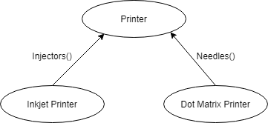
INHERITANCE: ABSTRACT CLASS
Is a class that has no instances.
Is written with the expectation that its concrete subclasses will add to its structure a behavior, typically by implementing its abstract operations

Slide 14
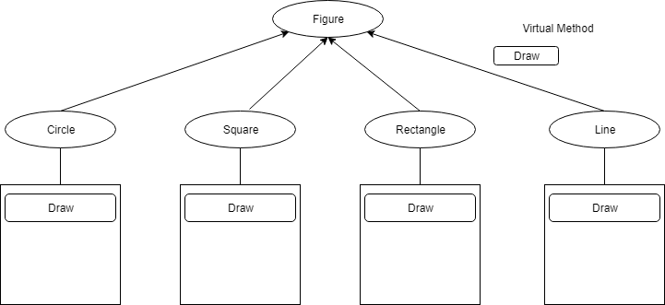
INHERITANCE - EXAMPLE: VIRTUAL METHOD

Slide 15
Visibility: Access Level
In certain languages, the visibility of the attributes and methods of a class can be defined:
Private: No private member of the superclass is visible in the subclass.
Protected: The protected members of the superclass are visible in the subclass, but not visible to the outside.
Public: The public members of the superclass are still public in the subclass.

Slide 16
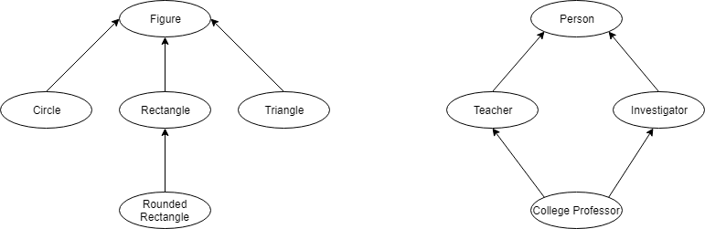
INHERITANCE: SIMPLE OR MULTIPLE
In certain programming languages, the inheritance can be simple or multiple.

Slide 17
POLYMORPHISM
Is the capacity by which different types of objects can respond to the same message in different ways
Overriding: means having two methods with the same method name and parameters. One of the methods is in the parent class and the other is in the child class, and allows a child class to redefine the implementation of a method that is already provided its parent class.
Overloading: occurs when two or more methods in one class have the same method name but different parameters.

Slide 18
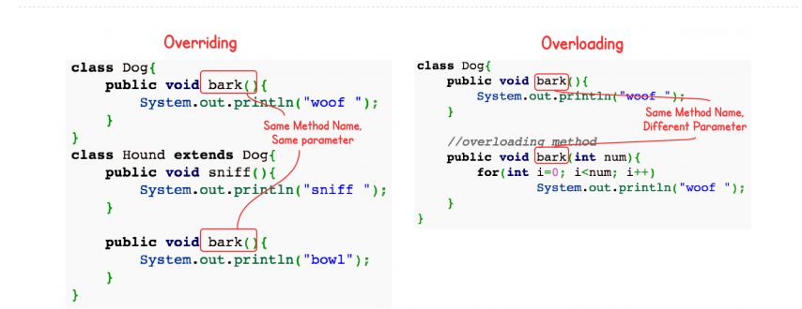
OVERRIDING AND OVERLOADING IN JAVA
I

Slide 19
ASSOCIATION
The association or aggregation could be defined as the moment in which two objects join to work together and thus achieve a goal.
Both objects are independent of each other.
To validate the association, the phrase "Use a" should make sense. The customer uses a credit card
Client is independent of Credit card, that is to say that we can create an object of type client and later associate an object of type credit card.
You can assign or remove the credit card, without affecting the existence of the Client.

Slide 20
COMPOSITION
Is a type of dependent relationship in which a more complex object is made up of smaller objects.
To validate the composition, the phrase "has a" should make sense. The car has a motor.
The objects that make up the container class must exist from the beginning.
Notes:
Inclusión de tipos de Objetos definidos por el usuario como partes de otros tipos de objetos.

Slide 21
COUPLING - COHESION
Coupling is the degree of interdependence between software modules; a measure of how closely connected two modules are.
Cohesion is the degree to which the elements inside a module belong together
High Cohesion and Low Coupling give us better-designed code that is easier to maintain.

Slide 22
CONTACT INFO
MariaAlejandra.Usart@endava.com
QA Community
Rosario - Argentina

